Slide 1

CRAVINGS
By SHARON SARAH JOSEPH
22PMC152

Slide 2
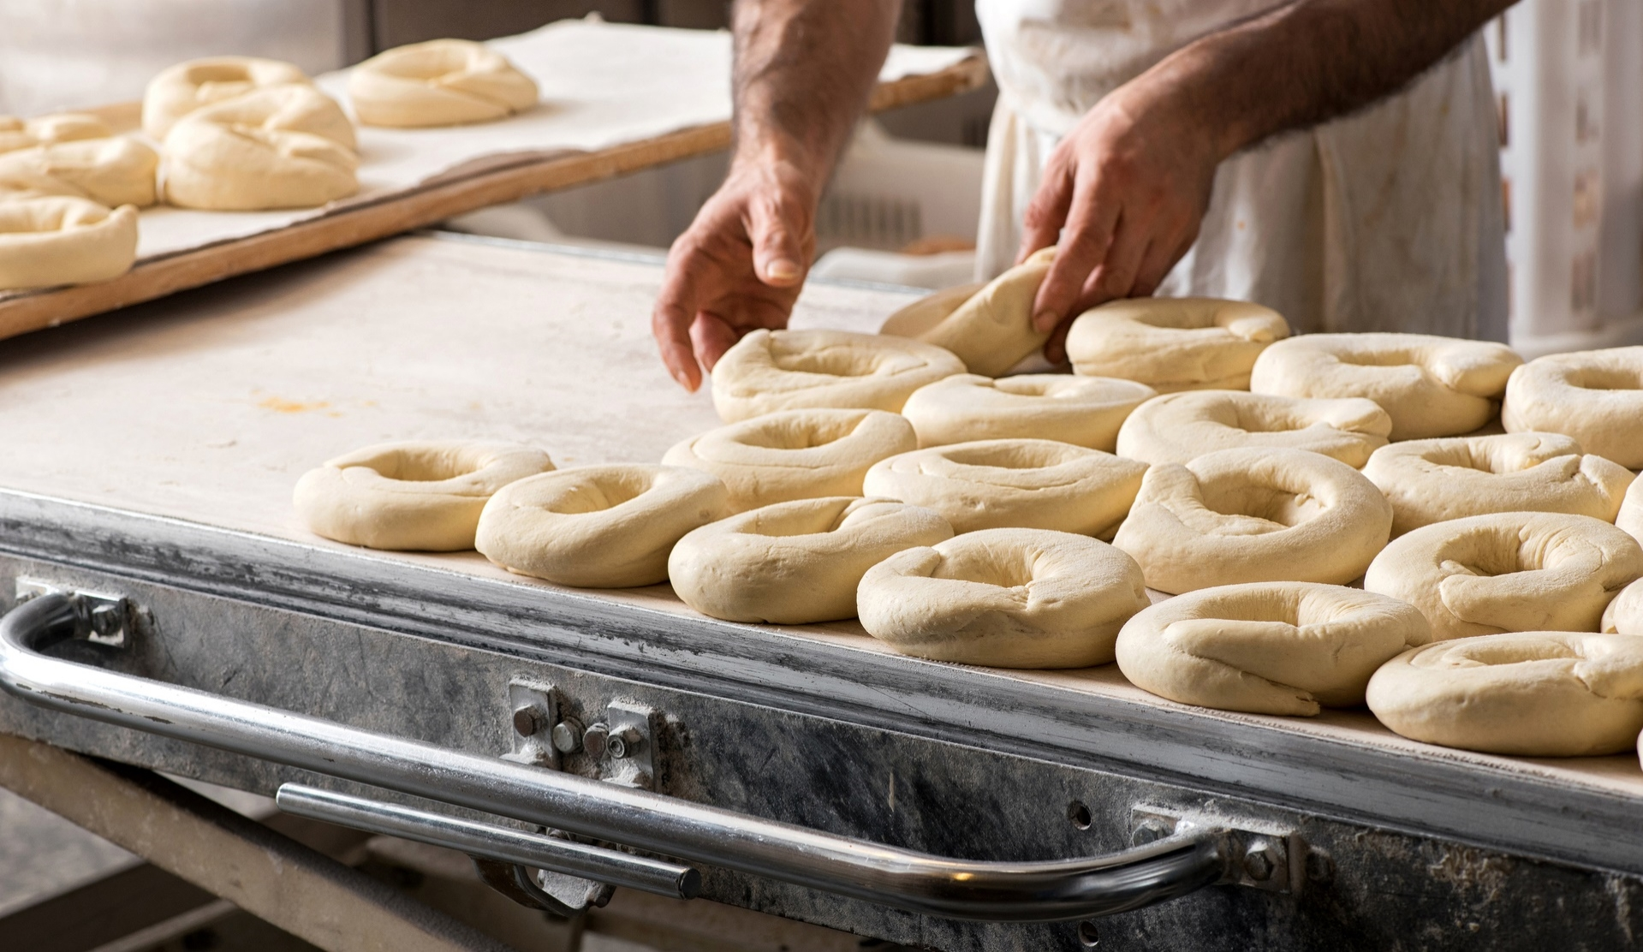

ABSTRACT
Cravings Recipe App is a web-based application designed to cater food enthusiasts and cooking enthusiasts who are looking for a convenient and user-friendly platform to discover, save, and share delicious recipes. The app is built using the Python programming language with the Django framework. The front-end of the application is developed using HTML, CSS, and Bootstrap, while the database is designed using SQLite3.
The primary goal of the Cravings Recipe App is to provide users with an easy and enjoyable experience when it comes to finding and exploring recipes. The app offers a wide range of features to enhance the recipe discovery process and user engagement. Users can create an account, sign in securely, and manage their profile within the app. They can browse through a diverse collection of recipes and search for specific recipes based on various criteria such as cuisine, and the chef who published the recipe.

Slide 3
REQUIREMENTS
Chef Functionality:
Chefs should have the ability to publish their recipes.
Chefs should be able to view and delete their own recipes.
User Functionality:
Users should be able to download recipes for offline access.
Registered users should be able to rate recipes.
Users should be able to filter recipes based on their type (veg/non-veg).
Users should be able to filter recipes based on specific chefs.
3.Profile Management:
Users and chefs should be able to manage their profiles.
Profile management should include updating personal information, profile picture.

Slide 4
REQUIREMENTS
4. Recipe Saving:
Users should be able to save recipes to their favorites or personal collections.
5. Recipe Sharing:
Users should have the option to share recipes via WhatsApp or other sharing platforms.
6. User Authentication and Authorization:
User authentication should be implemented to ensure secure access to user-specific functionalities.
7.Recipe Rating and Favorites:
Users should have the ability to rate and add recipes to favorites.

Slide 5
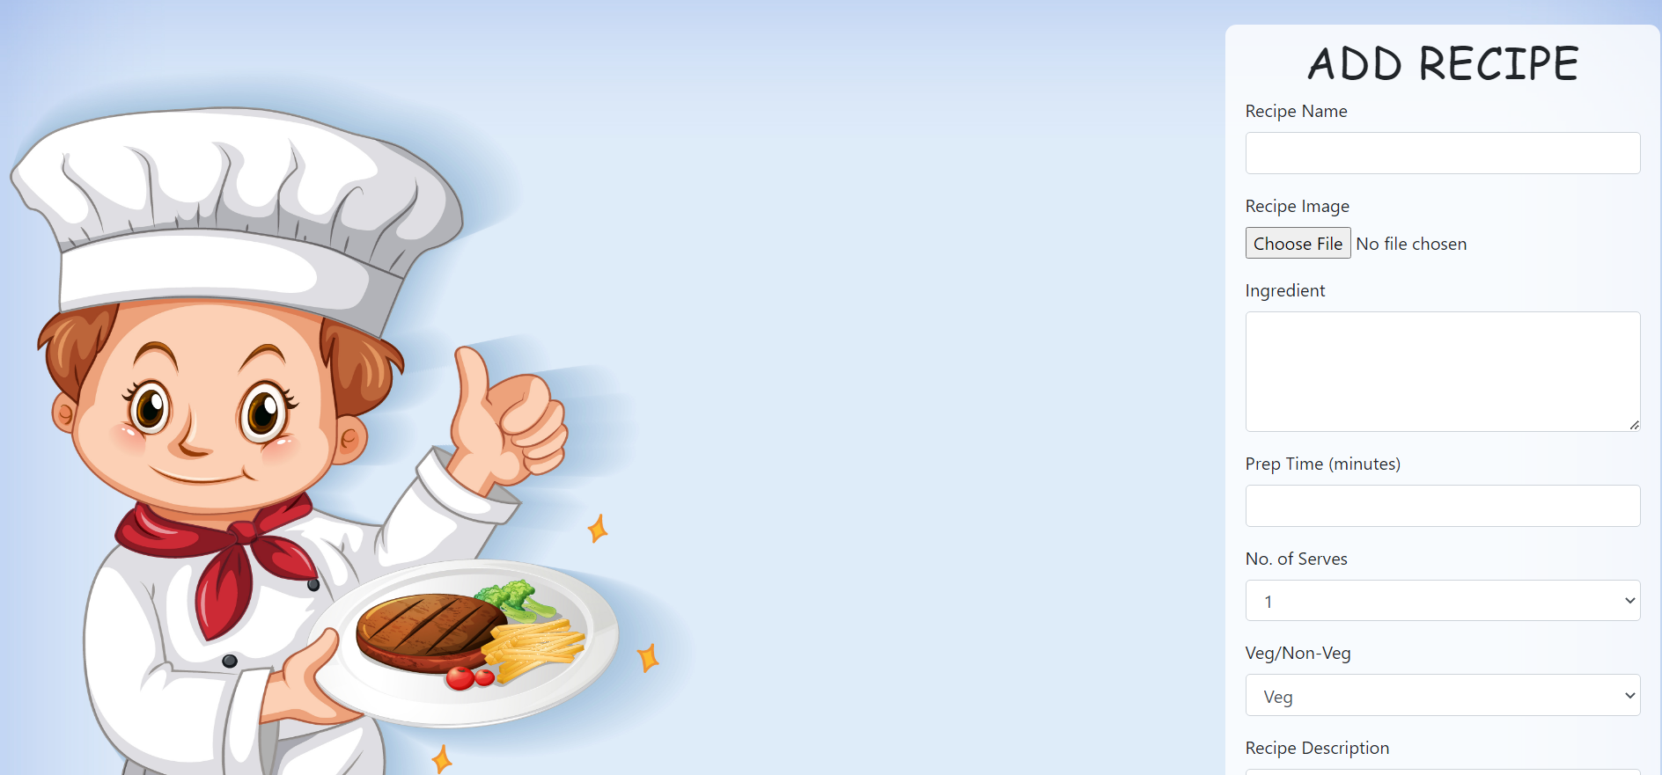
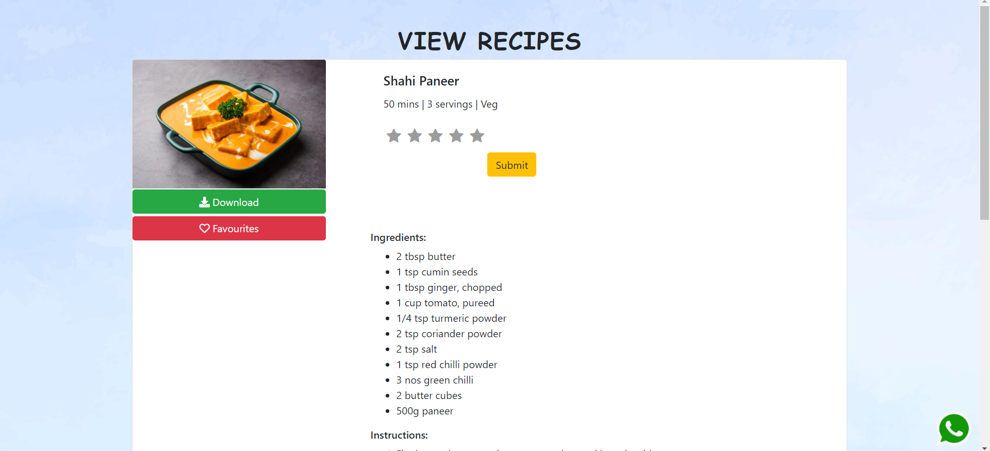
FEATURES
Recipe Publication:
Chefs can publish their own recipes, showcasing their culinary creations to a wider audience.
Recipes can include detailed instructions, ingredients, cooking time, and difficulty level.
Recipe Management:
Chefs have the ability to view and delete their published recipes, providing control and flexibility over their content.
Recipe Download:
Users can download recipes for offline access, allowing them to refer to recipes even without an internet connection.

Slide 6
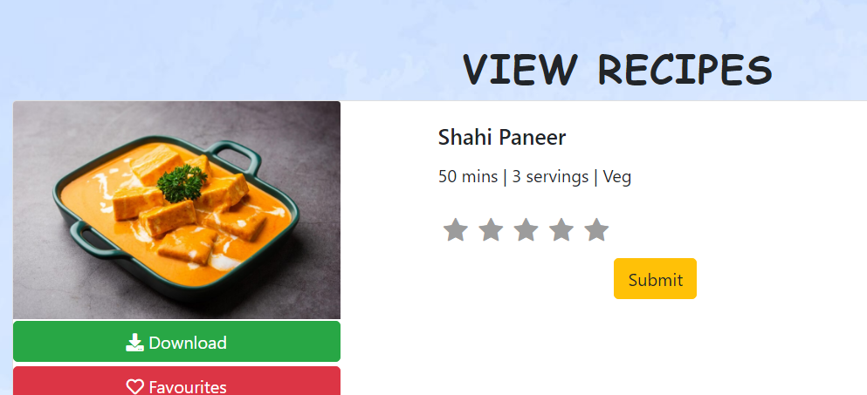
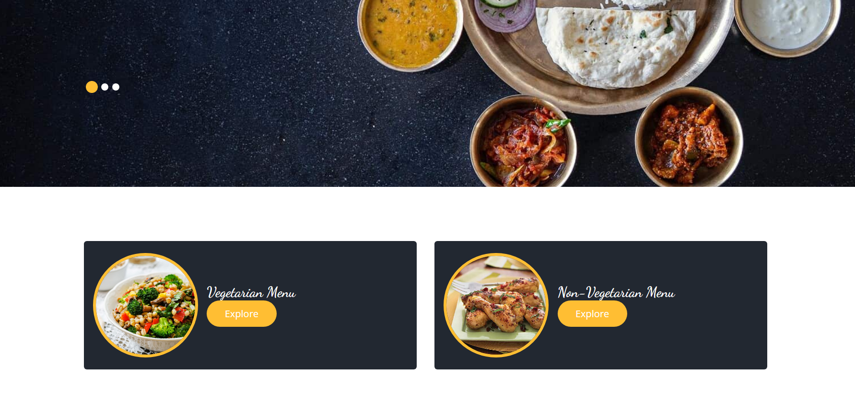
FEATURES
4.Recipe Rating:
Registered users can rate recipes which help others make informed decisions.
Users can view average ratings to gauge the quality and popularity of recipes.
5.Recipe Filtering:
Users can easily filter recipes based on their preferences, such as vegetarian or non-vegetarian options.
Filtering based on specific chefs allows users to explore recipes from their favorite culinary experts.
6. Recipe Saving (Add to Favorites):
Users have the option to save recipes to their favorites, enabling quick access to their preferred recipes.
Saving recipes allows users to create personalized collections and organize recipes based on their preferences.
7. Recipe Sharing:
Users can easily share recipes with others via popular platforms like WhatsApp.

Slide 7


TECHNICAL ASPECTS
Backend Development:
The app is built using Python as the primary programming language.
The Django framework is used to handle the backend development, including routing, database interactions, and business logic.
Django provides a robust and scalable foundation for building web applications.
Frontend Development:
HTML, CSS, and JavaScript are used for designing and developing the frontend of the app.
Bootstrap framework is utilized to create a responsive and visually appealing user interface.
JavaScript may be used for dynamic functionality, such as interactive features or form validations.

Slide 8
TECHNICAL ASPECTS
Database Management:
The app uses a database management system, such as SQLite or other relational databases like MySQL or PostgreSQL, to store and retrieve recipe data, user information, and other relevant data.
User Authentication and Authorization:
Django's built-in authentication system is leveraged for user registration, login, and session management.
User roles and permissions are implemented to differentiate between chefs and registered users, allowing for appropriate access to functionalities.
Recipe Management:
Django's models are used to define the structure and relationships of the recipe data.
CRUD (Create, Read, Update, Delete) operations are implemented to allow chefs to add, edit, and delete their recipes.
Ratings and Favorites:
Database models are created to store and manage ratings and add recipes to favorites.
User interface components are implemented to allow users to rate recipes

Slide 9
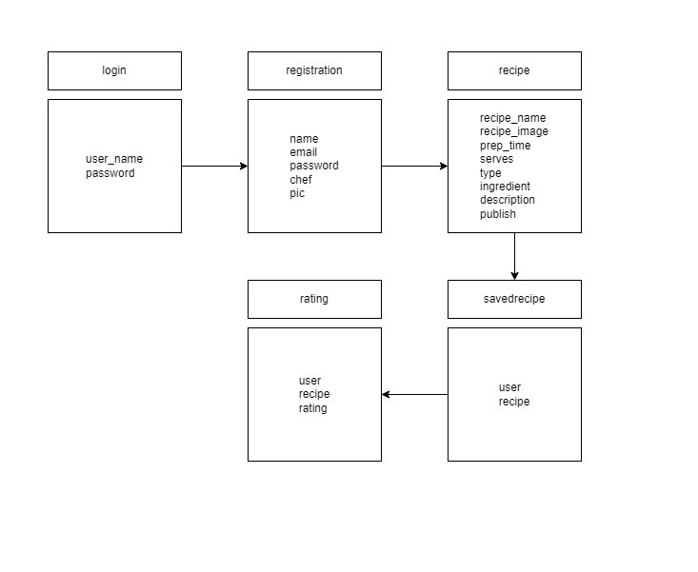
CLASS DIAGRAM

Slide 10
CHALLENGES
Implementing secure user authentication, managing user sessions, and handling authorization.
Calculating and updating the average rating of a recipe in real-time can be computationally intensive, especially as the number of recipes and user ratings increases.
Creating an intuitive and visually appealing user interface & Designing the database schema and modeling the relationships between entities.
Incorporating real-time updates to display changes in ratings or recipes dynamically can be challenging.
Implementing form validations for various user inputs, including during user registration, recipe submission, and profile updates, is crucial to maintain data integrity and provide a smooth user experience.
Adding a recipe to favorites and preventing duplication

Slide 11
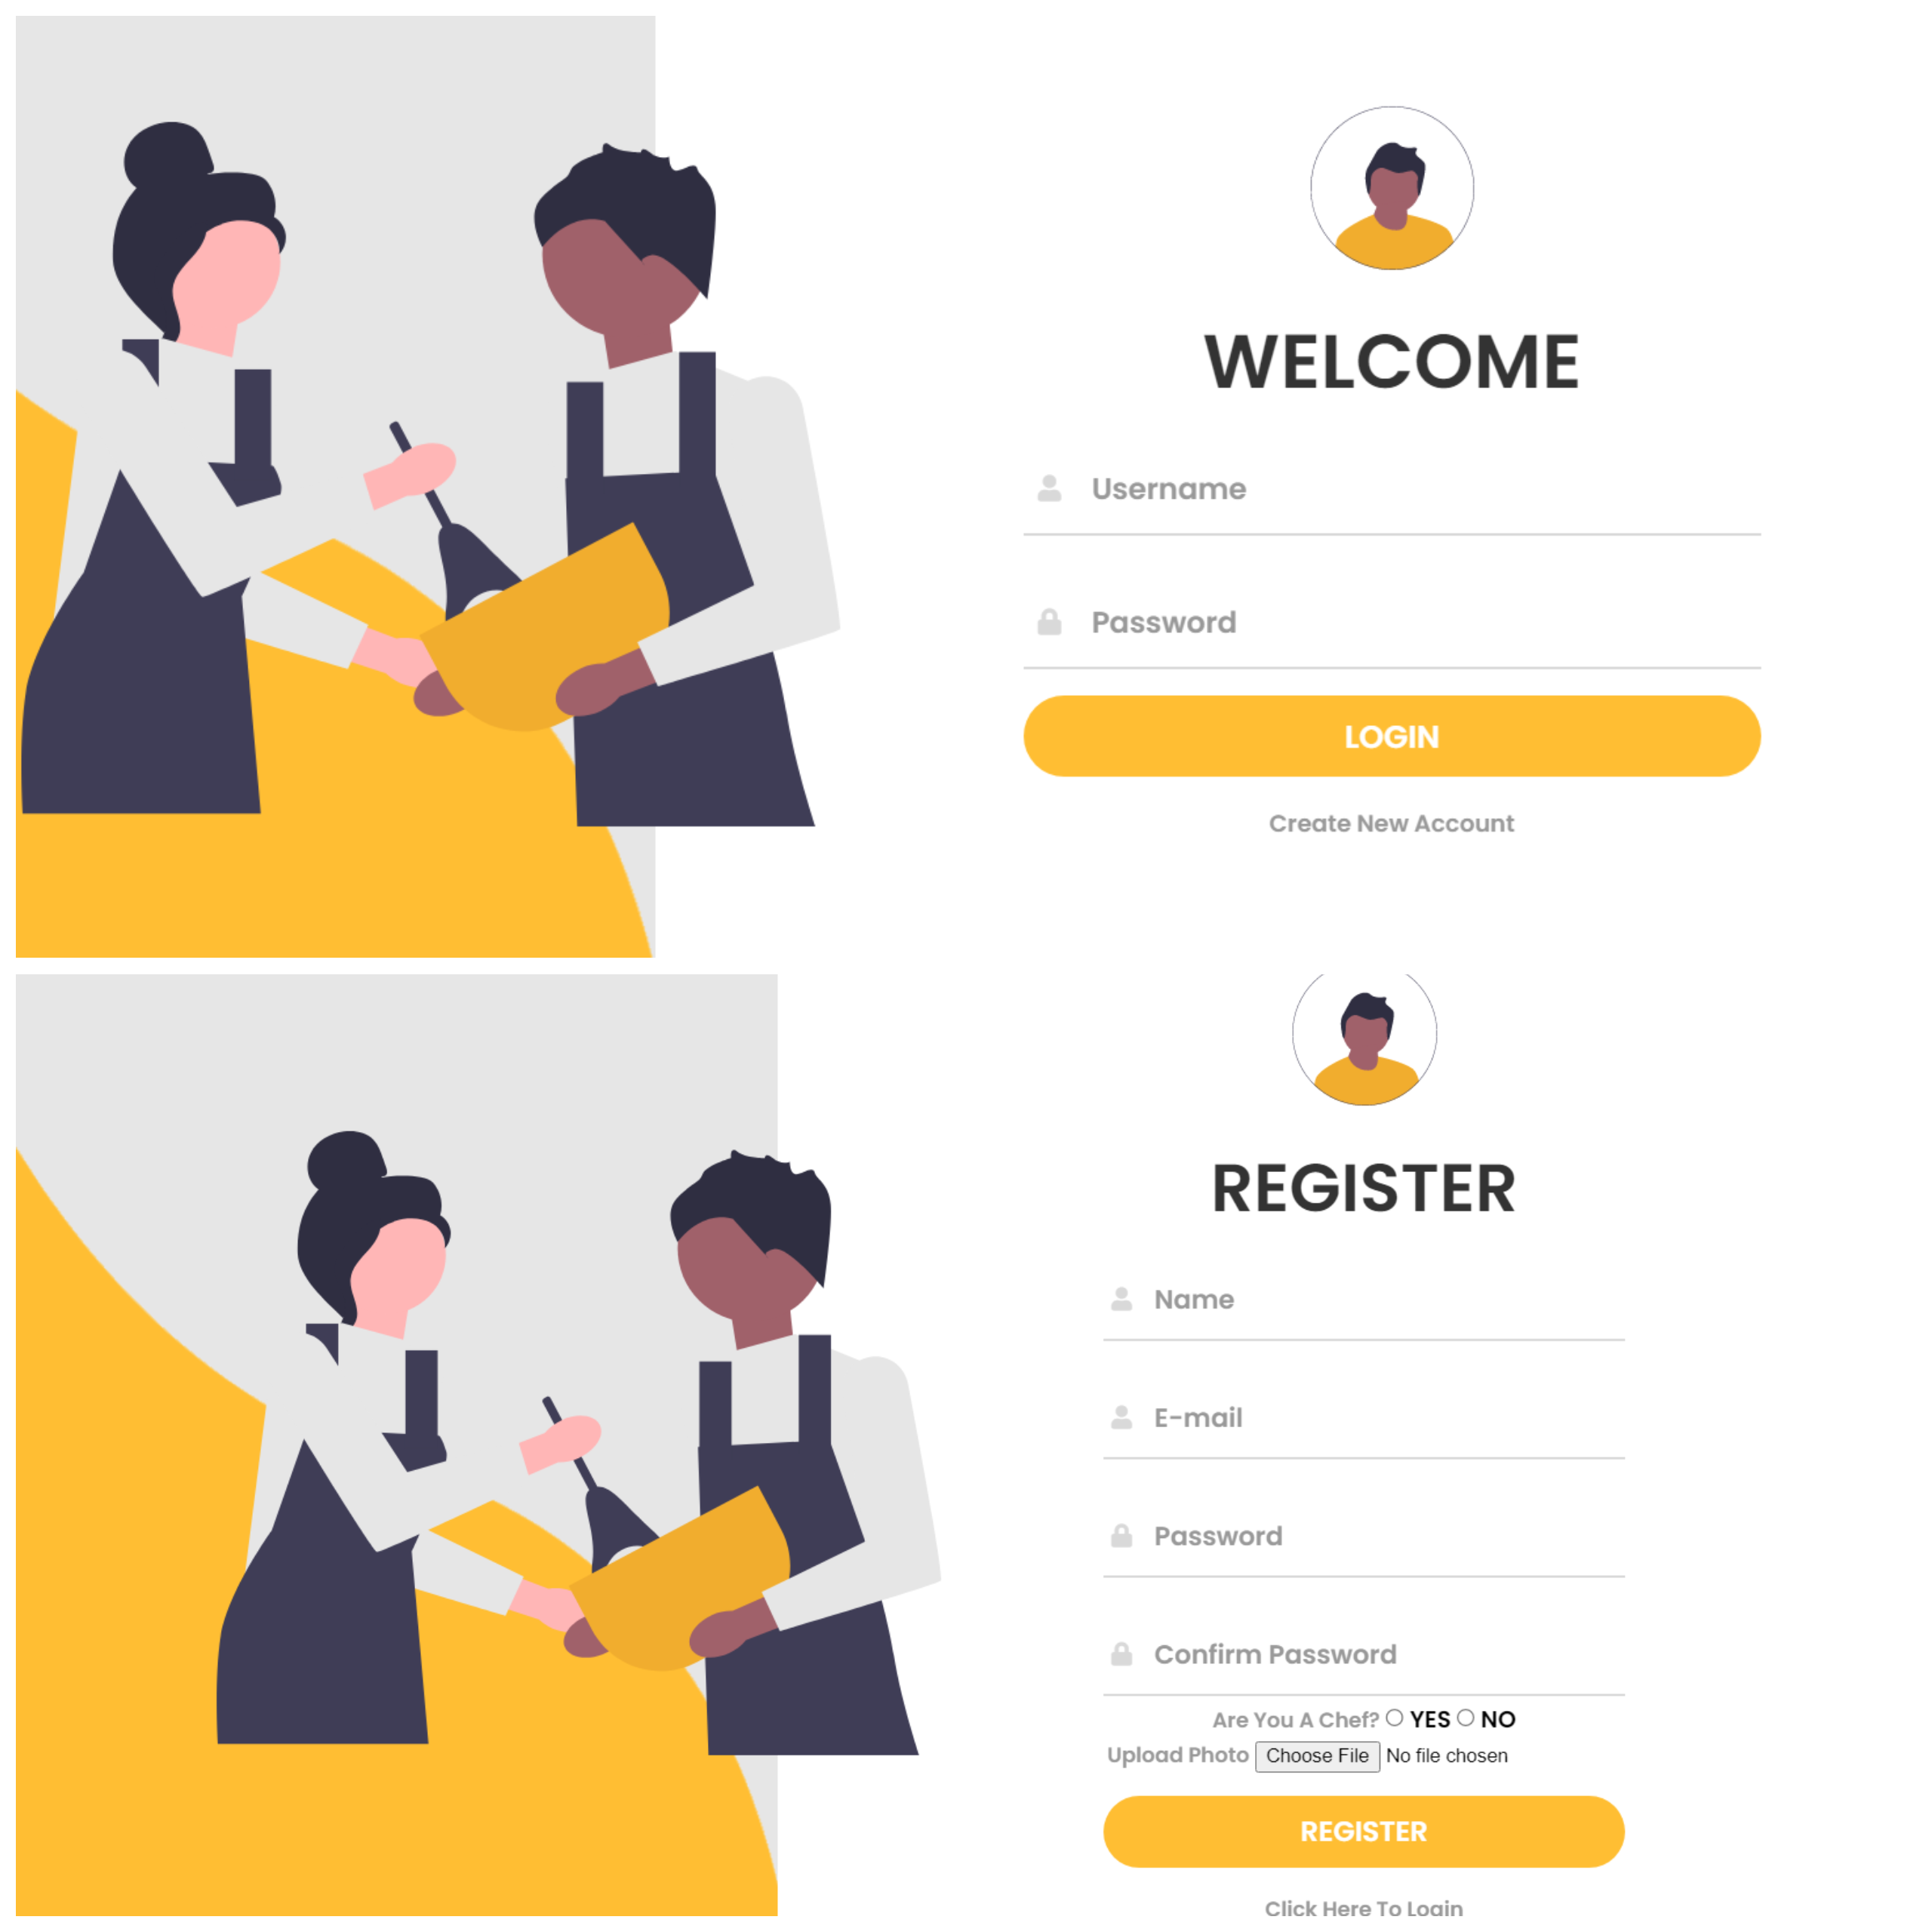
SCREENSHOTS WITH EXPLAINATION
LOGIN/REGISTRATION
Registration: Users can create an account by providing their basic information such as name, email address, and password. The registration form should include validation checks to ensure the entered data is valid and unique (e.g., checking for existing email addresses).
Login: Registered users can log in using their email address and password. The login process involves verifying the user's credentials against the stored information in the database. If the provided information matches, the user is granted access to their respective accounts.

Slide 12
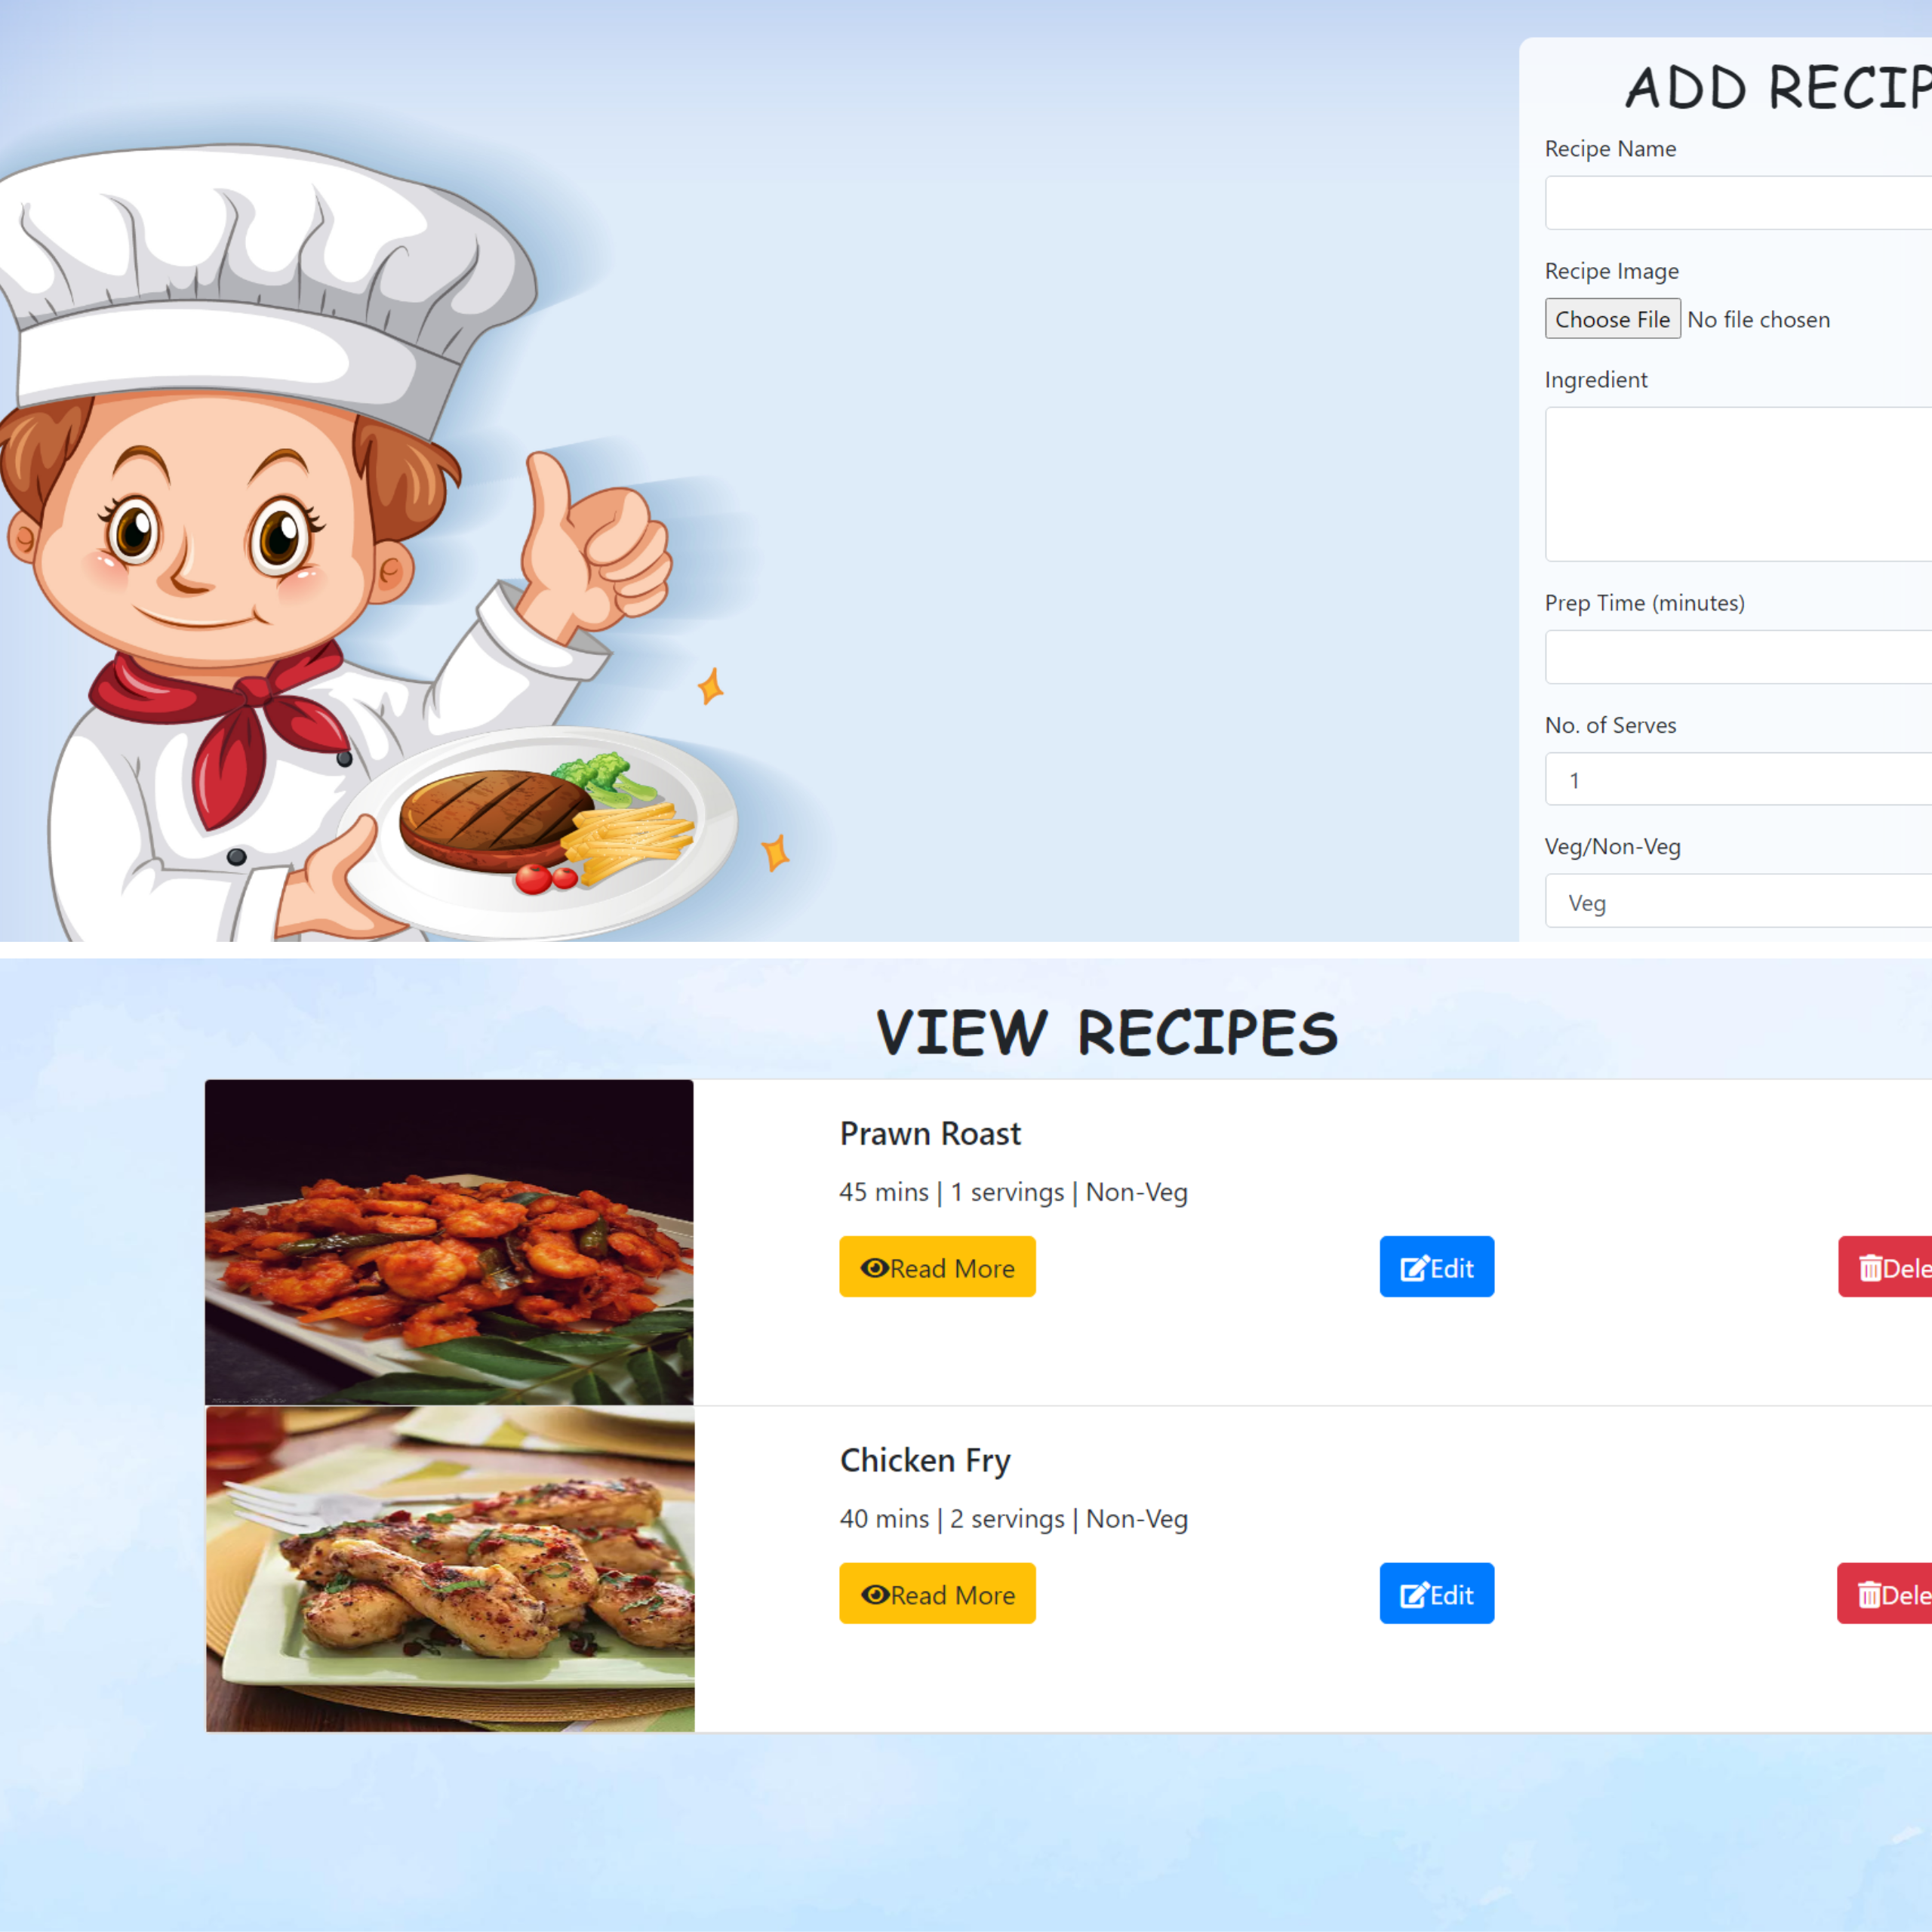
SCREENSHOTS WITH EXPLAINATION
ADD/VIEW RECIPES
Add Recipes:
Chefs can create and publish their own recipes through the app.
They can provide details such as recipe title, description, ingredients, cooking instructions, preparation time, and cooking time.
The app should include form validations to ensure that all necessary information is provided and in the correct format.
Upon submission, the recipe should be saved to the database and made available for other users to view.
View Recipes:
Chefs can access a dedicated section where they can view all the recipes they have added.
The recipes should be presented in a clear and organized manner, displaying essential information such as the recipe title, an image (if available), and a brief description.
Chefs may have additional options to edit or delete their recipes directly from the view recipes section.

Slide 13
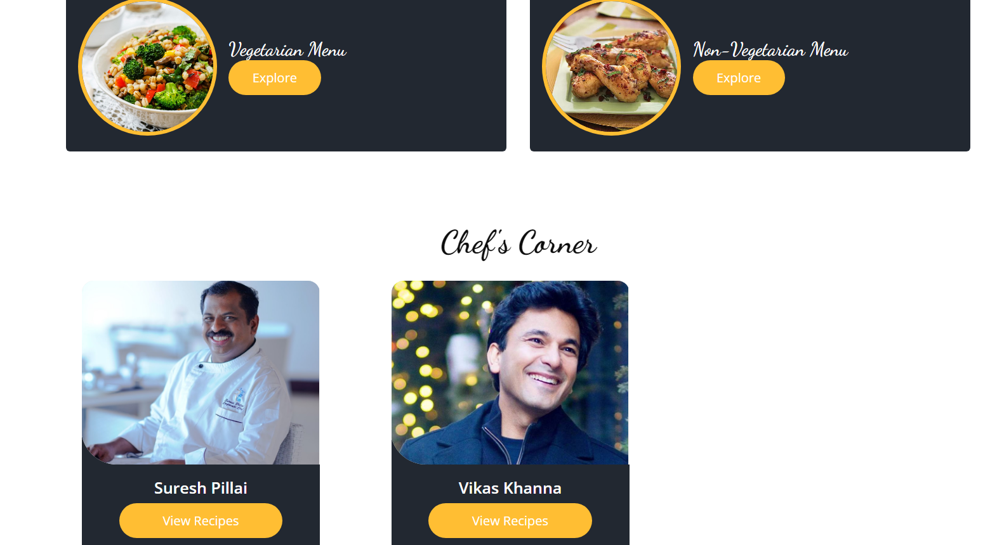
SCREENSHOTS WITH EXPLAINATION
FILTERING ON HOMEPAGE
The app provides an option for users to filter recipes based on their dietary preferences, specifically whether they prefer vegetarian or non-vegetarian recipes.
Users can select the desired filter (e.g., "Veg" or "Non-Veg") from the homepage or a dedicated filtering section.
When the filter is applied, the app displays only those recipes that match the selected dietary preference. For example, if the user selects "Veg," the app will show only vegetarian recipes, and if they select "Non-Veg," it will display only non-vegetarian recipes.
The app allows users to filter recipes based on specific chefs.
Users can either choose from a list of available chefs.
When a chef is selected or searched for, the app displays only the recipes associated with that particular chef.

Slide 14
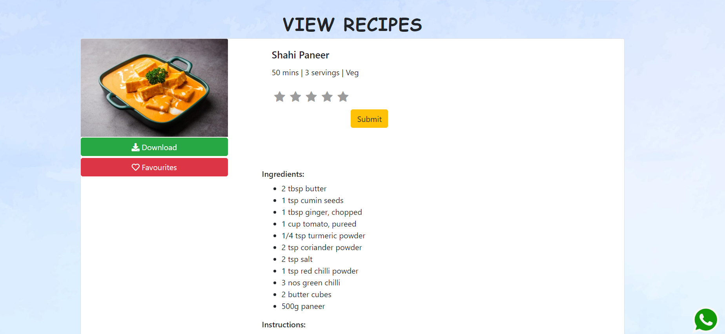
SCREENSHOTS WITH EXPLAINATION
Download Recipe: The Download function in the allows users to save recipes offline for later access. Users can download recipe files in a compatible format (such as PDF) to their devices, enabling them to view and follow the recipes without an internet connection.
Add To Favorites: The "Add to Favorites" function in the app allows users to save their favorite recipes with a single click, creating a personalized collection of recipes they can easily access later. Once a recipe is added to favorites, users can quickly view and access their saved recipes from their profile.
Rating: Users can provide ratings for recipes, indicating their satisfaction with a particular recipe. The average rating is calculated by aggregating the ratings provided by individual users for a specific recipe and is displayed on the user homepage.

Slide 15
FUTURE ENHANCEMENT
Personalized Recipe Recommendations: Implement machine learning algorithms to provide personalized recipe recommendations based on users' preferences
Advanced Search and Filters: Enhance the search functionality by incorporating advanced filters such as ingredient-based search, cuisine types, dietary preferences, and cooking time.
Shopping Integration and Meal Planning: Integrate with grocery delivery services or enable users to create shopping lists directly from recipes. Additionally, offer meal planning features that allow users to schedule recipes for specific days
Nutritional Information and Allergen Labels: Provide nutritional information for recipes, including calorie counts and allergen labels.

Slide 16



CONCLUSION AND REFERENCES
In conclusion, the Cravings app is a comprehensive and user-friendly platform designed to enhance the cooking and recipe discovery experience.
With features such as recipe publishing, user ratings, filtering options, and profile management, the app caters to both chefs and users alike. The app's user-centric approach, intuitive interface, and potential future enhancements like personalized recommendations, social interactions ensure that it stays relevant and continues to meet the evolving needs of cooking enthusiasts.
REFERENCES
Chatgpt
https://themewagon.com/theme-tag/restaurant-template/
https://www.youtube.com/watch?v=t-EMinSz_Tk

